Slide 1
Programming Fundamentals
NodeJS & Javascript
Web3 Development for Beginners

Slide 2
What is Javascript?
Started as a programming language to support HTML (Websites)
Evolved into a language that can do most user-facing applications:
Slack is developed using Javascript
Discord is developed using Javascript
Serves as a tool for many non-javascript projects
Javascript is a must-know in today's tech-world

Slide 3
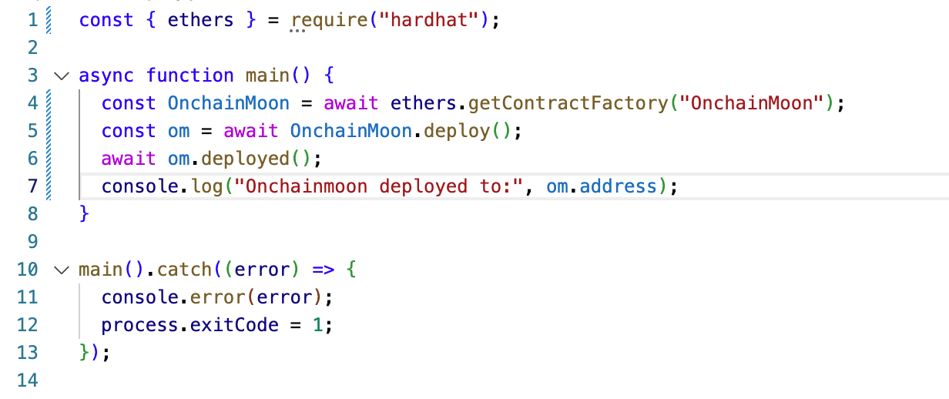
What does Javascript look like?

Slide 4
Let’s get started!
You need to install:
Nodejs
Npm
Follow instructions here: https://docs.npmjs.com/downloading-and-installing-node-js-and-npm

Slide 5
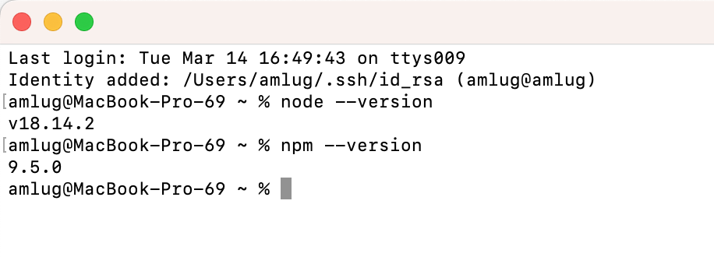
Verify it is running:

Slide 6
Install Visual Studio Code
https://code.visualstudio.com/

Slide 7
Let’s build a first nodejs program
Follow along!

Slide 8
Recap
You now have nodejs and npm up and running
You have build your very first nodejs program
Now we have all we need to move onto Solidity

